Slide 1
Nanoservice-enabled event-driven
clinical decision support REST APIs
Hyponatremia Diagnosis Demo
For more information about Nanoservice, please visit https://csml.uconn.edu/

Slide 2
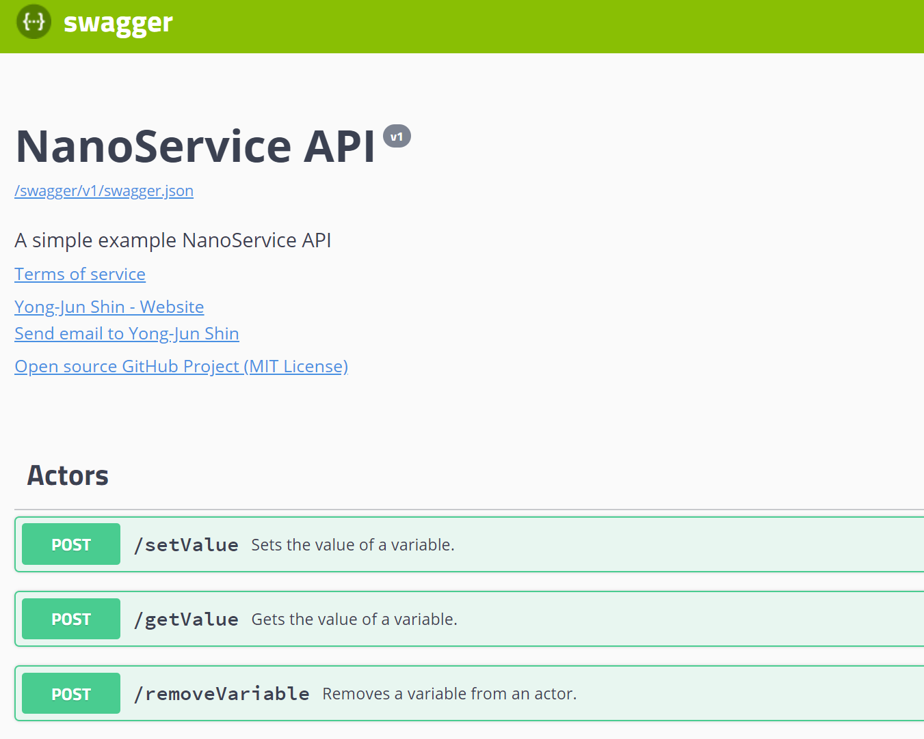
Step 1. Go to http://csmlab7.uconn.edu/swagger/

Slide 3
Step 2. [setValue] Click “[POST] /setValue”

Slide 4
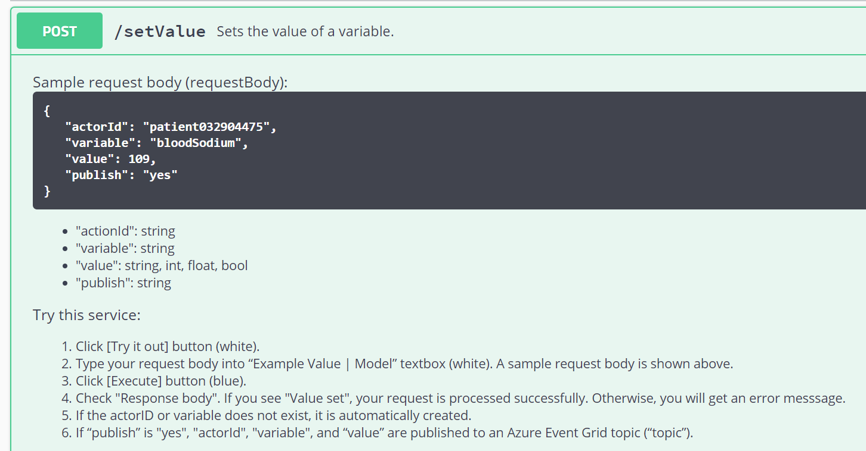
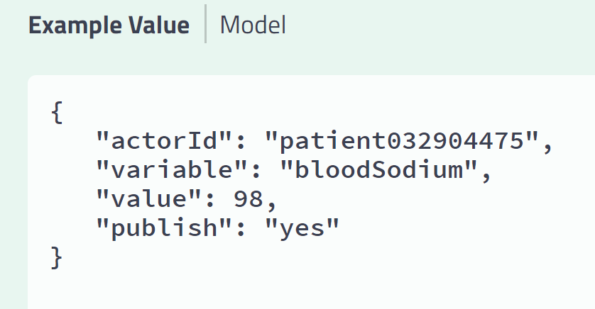
Step 3. [setValue] Set the value of the variable “bloodSodium” to 98 by following the instruction.
If the actor ID or variable does not exist, it will be automatically created.
If “publish” is “yes”, "actorId", "variable", and “value” are published to an Azure Event Grid topic (“topic”).

Slide 5
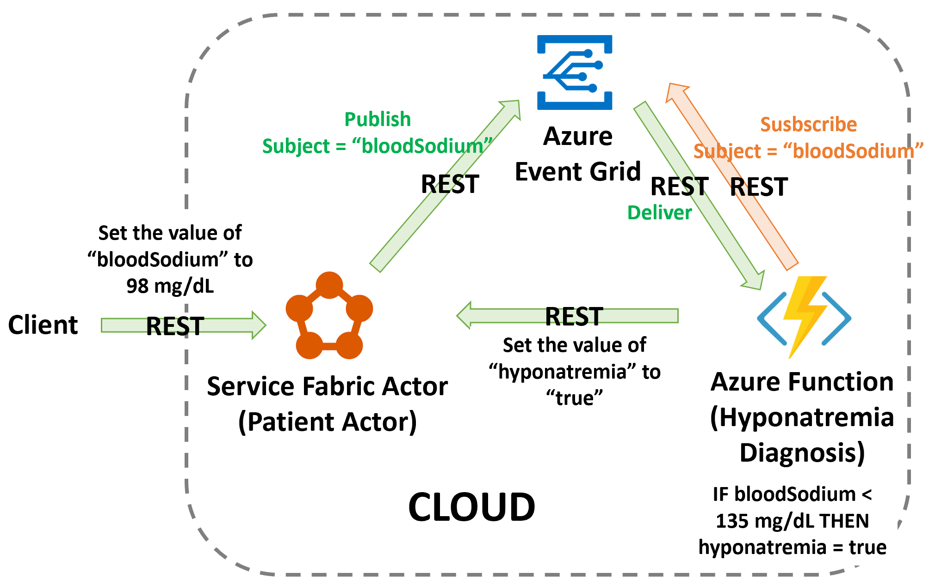

Slide 6
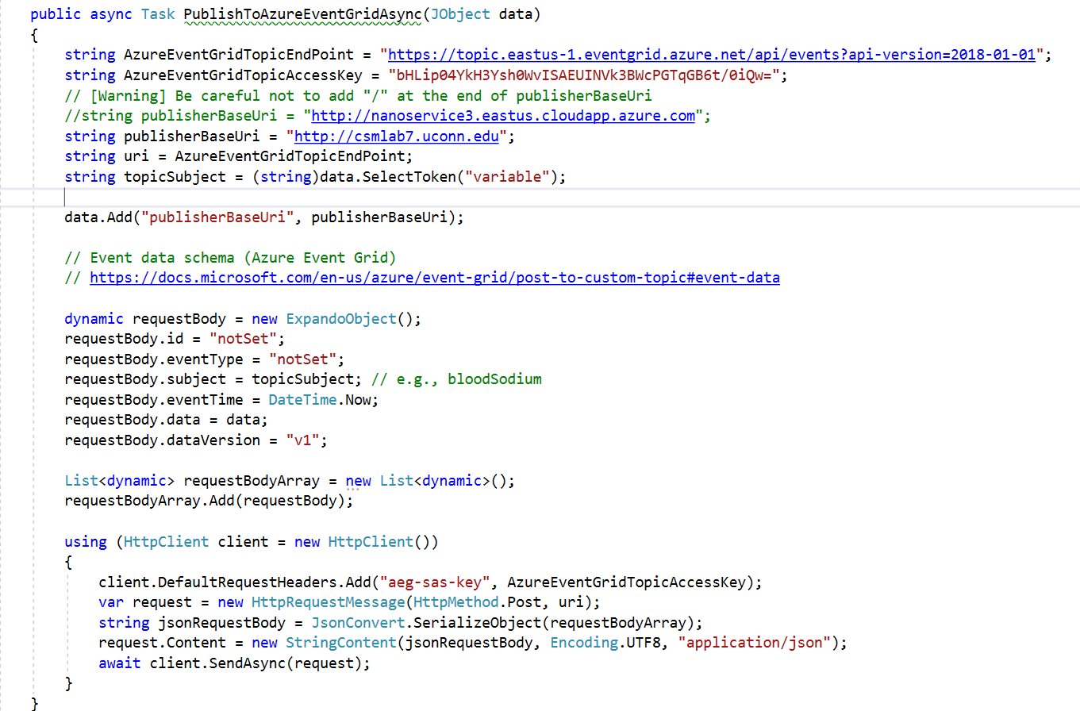
The code for publishing an event to Azure Event Grid
https://azure.microsoft.com/en-us/services/event-grid/
The source code is available at: https://github.com/yshin1209/Nanoservice

Slide 7
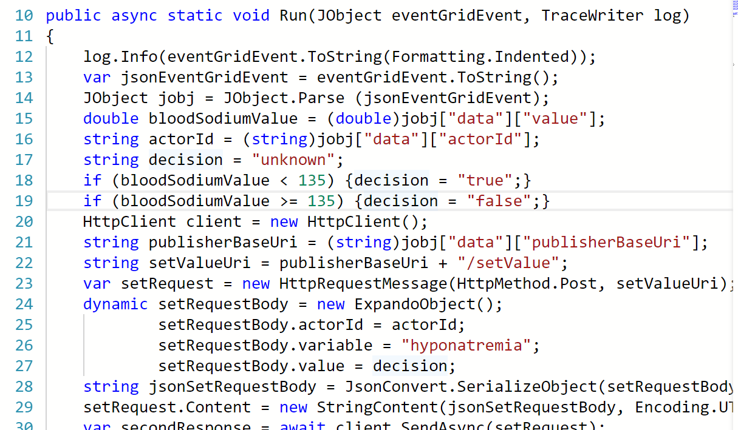
Azure Function https://azure.microsoft.com/en-us/services/functions/
The Hyponatremia Diagnosis Function 1) decides whether there is hyponatremia or not, 2) adds a new variable “hyponatremia” to the patient actor in case the variable is not yet added and sets the value to true (hyponatremia) or false (not hyponatremia).

Slide 8
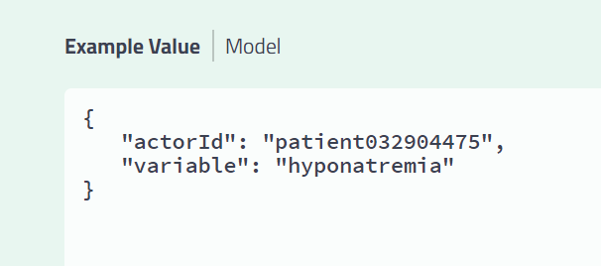
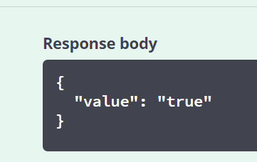
Step 4. [getValue] Get the value of the variable “hyponatremia” which is now “true” (because 98 < 135)

Slide 9
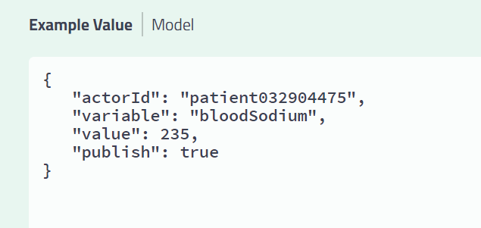
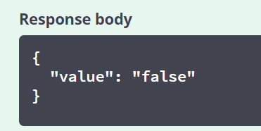
Step 5. [setValue] Set the value of the variable “bloodSodium” to 235.
Step 6. [getValue] Get the value of the variable “hyponatremia” which is now “false” (because 235 > 135)

Slide 10
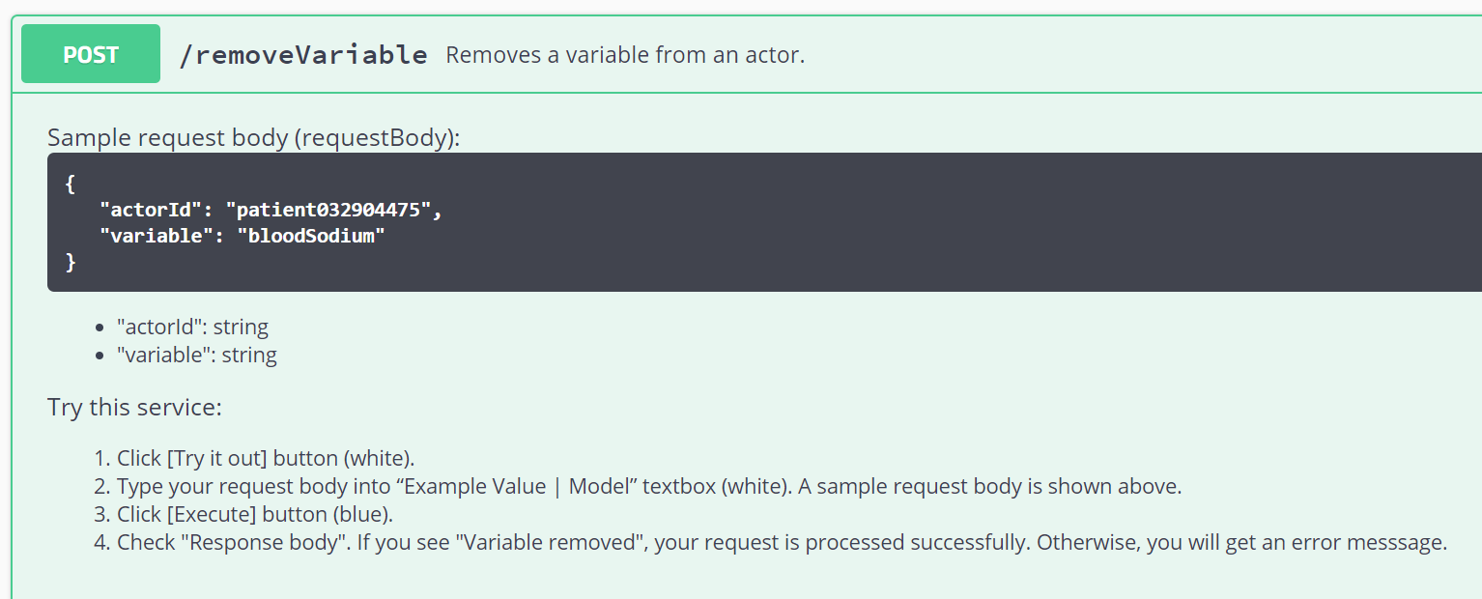
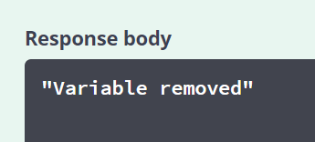
Step 7. [removeVariable] Remove the variable “bloodSodium”.
For more information about Nanoservice, please visit https://csml.uconn.edu/

